Slide 1



Identification of Redundant Code Using AI
Jaypee University of Information Technology, Waknaghat - 173234 (India)
Major Project - I (18B19CI791) | AY 2024-25
End-Term Presentation
Group No.: 86
Team Member (s)
Samriti Thakur (211150)
Piyush Joshi (211397)
Prakhar Varshney(211327)
Supervisor (s)
Dr. Ramesh Narwal
Assistant Professor
CSE&IT
Ms. Seema Rani
Assistant Professor
CSE&IT

Slide 2
Outline
Introduction
Problem Statement
Objectives
Work Done (after Mid-Term Evaluation)
Project Design
Implementation
Experimental Results and Evaluation
Key Learnings
Work Plan for Next Semester
Work Contribution of Each Member
Supervisor Remarks
References

Slide 3
Introduction
Code redundancy, or duplicated code (code clones), is a common issue in software development. It occurs when developers replicate code segments to save time or due to a lack of collaboration. While this may seem convenient initially, redundant code increases codebase size, complicates maintenance and can introduce inconsistencies or bugs when updating code.
The "Identification of Redundant Code Using AI" project aims to address this challenge by employing machine learning (ML) and natural language processing (NLP) techniques. Using advanced ML models, the project will automatically identify both exact and semantic code clones. By training on a dataset of labeled redundant code patterns, the system will be able to detect clones across large codebases, highlighting areas for refactoring and improving code quality.
This AI-based approach will streamline code maintenance, reduce duplication, and contribute to more efficient software development practices by producing cleaner more maintainable code.

Slide 4
Problem Statement
Code redundancy, or "code clones," occurs when identical or near-identical code segments are scattered across a codebase due to copy-pasting or unintentional duplication.
This leads to increased codebase size, makes maintenance more difficult, and introduces the risk of inconsistencies when changes are applied to only one instance of a clone.
Traditional methods, like manual reviews or text-based detection, often miss "near-miss" clones, where minor changes exist, or semantic clones, where the code behaves the same but looks different.
As codebases grow, manual identification and refactoring of redundant code becomes impractical, resulting in decreased efficiency and increased technical debt.
The need arises for an automated solution capable of detecting both exact and semantic code clones to help developers maintain cleaner, more efficient codebases.

Slide 5
Objectives
Automate Detection of Code Clones: Develop an AI-based system that can efficiently detect both exact and semantic code clones across large codebases, reducing the manual effort involved in identifying redundant code.
Improve Codebase Quality: Minimize code duplication and technical debt by identifying areas of the code that can be refactored, ensuring cleaner, more maintainable, and scalable software development.
Enhance Development Efficiency: Provide developers with actionable insights through automated clone detection reports, enabling quicker identification of redundant code and faster resolution during the development and maintenance processes.
Create a User-Friendly Tool for Code Clone Detection: To develop an intuitive and effective tool that integrates the AI model and allows users to easily scan their codebases for redundant code patterns.

Slide 6
Work Done (after Mid-Term Evaluation)
Dataset Preparation
Designed and built a custom dataset comprising various different code pairs across multiple programming languages like (python, c, c++, java).
Annotated dataset with metadata such as redundancy type, complexity score, and line counts.
Model Development
Implemented a deep learning model leveraging shared LSTM layers for semantic code comparison.
Designed a dual-input architecture to process and compare tokenized code pairs.
Utilized tokenization, embedding layers, and sequence padding for effective preprocessing.
Implementation and Testing
Trained the model on the dataset using binary cross-entropy loss and Adam optimizer.
Achieved initial validation through metrics like accuracy

Slide 7
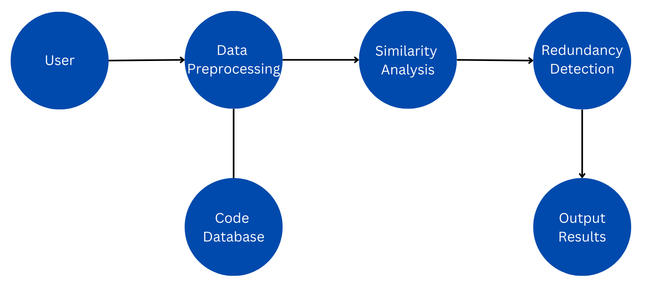
Project Design
Data Flow Diagram (DFD) for Redundant Code detection System.
Figure 1
Redundant Code detection Flow chart

Slide 8
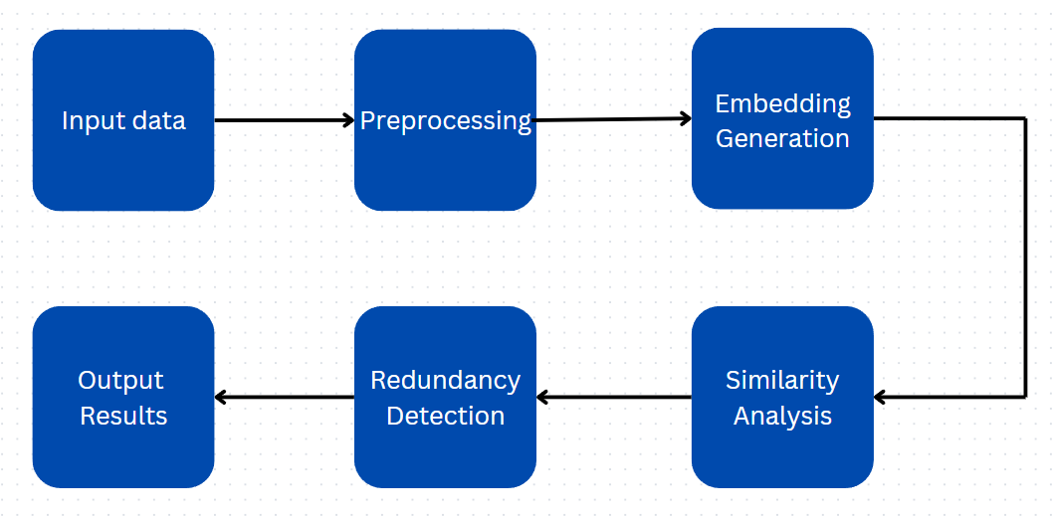
Project Design (cont…)
Data Flow Diagram (DFD) for Redundant detection model.
Figure 2
Redundant detection model data flow diagram

Slide 9
Implementation
Dataset Overview:
Our dataset currently consists rows of code pairs.
Each row contains two code snippets along with their similarity label.
Programming languages included: Python, Java, C++, and C.
Key Features:
Similarity Labels: Indicate if the code snippets are similar (1) or dissimilar (0).
Diversity: Covers multiple programming languages to ensure robust results.
Sample Dataset Structure:
Code Snippet 1: def add(a, b): return a + b
Code Snippet 2: int add(int a, int b) { return a + b; }
Similarity Label: 1

Slide 10
Implementation (cont…)
Dataset example:
{ "original_code":
"comparison_code":
"is_redundant":
"language":
"redundancy_type":
"complexity_score":
"metadata":
"id": }
Core Implementation Details:
Data Preprocessing: Tokenization of code snippets to convert them into analyzable formats.
Similarity Calculation: Custom algorithm for identifying lexical and structural patterns.
Redundancy Detection: Assignment of similarity labels using a scoring function.

Slide 11
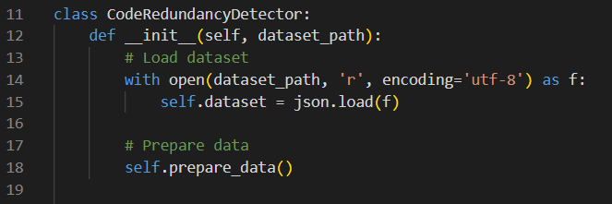
Implementation (cont…)
Key Code Snippets:
Tools and Techniques:
Programming Languages Used:
Python for implementation and analysis.
Support for other languages (Java, C++, C, Python) in the dataset.
Techniques Employed:
Tokenization, Lexical Analysis, Similarity Scoring.
Tools Utilized:
Python libraries for preprocessing and analysis.
VS Code for development and testing.

Slide 12
Experimental Results and Evaluation
Key Findings
Accuracy and Performance:
Current implementation achieves 86% accuracy in detecting redundant code (specific percentage can be filled based on your actual results).
Handles small dataset (70 rows) effectively, demonstrating reliability on initial tests.
Insights from Redundancy Detection:
Effective in identifying identical and near-identical code snippets across Python, C++, C, and Java.
Detected patterns in common programming logic duplication (e.g., loops, conditional checks).

Slide 13
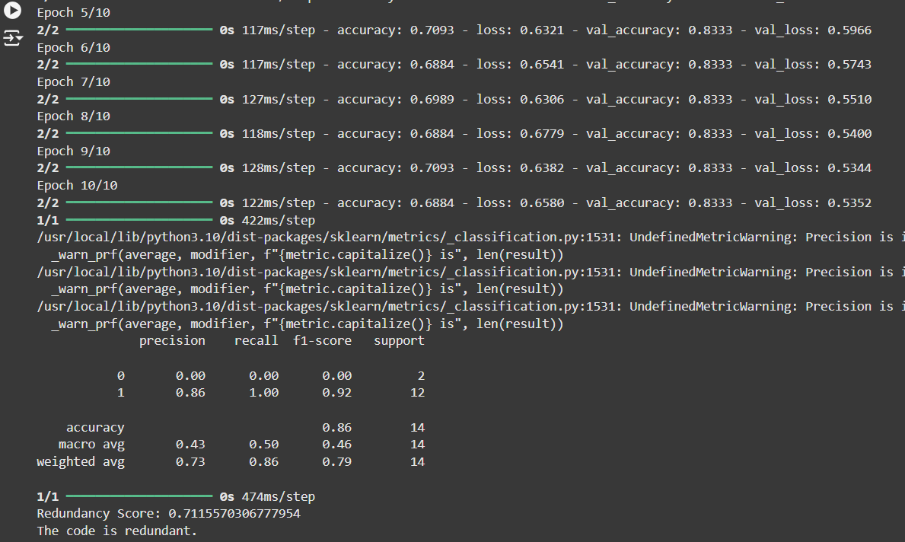
Experimental Results and Evaluation (cont…)
Output of the implemented redundancy detection model
Figure 3
Screenshot of output

Slide 14
Key Learnings
Understanding Code Redundancy
Gained insights into the patterns and structures of redundant and non-redundant code.
Identified key challenges in detecting subtle variations in redundant code.
Dataset Development
Learned the importance of creating a balanced and diverse dataset for training machine learning models.
Experienced challenges in sourcing and labeling code pairs across multiple programming languages.
Model Design and Training
Explored deep learning architectures like LSTMs and pretrained models such as CodeBERT.
Understood the significance of preprocessing for model accuracy.

Slide 15
Work Plan for Next Semester
Dataset Expansion
Increase the dataset size and include code pairs across multiple programming languages (Python, C++, Java, etc.) to enhance diversity.
Ensure balanced labeling of redundant and non-redundant code pairs for effective training.
Utilizing Pretrained CodeBERT Model
Fine-tune the pretrained CodeBERT model on our expanded dataset for code similarity and redundancy detection.
Leverage CodeBERT’s contextual understanding of programming languages to improve prediction accuracy.
Performance Evaluation
Compare the performance of the current custom-built LSTM-based model with the fine-tuned CodeBERT model.

Slide 16
Work Contribution of Each Member
S. No. | Roll No. | Work Done | Work Contribution (%)
1. | 211397 | Worked on dataset development and integration. Worked on implementing and deploying the redundancy detection model. Worked on preparing for the end-term evaluation and documentation. | 33.3%
2. | 211150 | Analyzing and research on selecting appropriate models. Researched and contributed for the dataset development. Worked on preparing for the end-term evaluation and presentation. | 33.3%
3. | 211327 | Researched and contributed for the dataset development. Worked on documentation and preparing the report for end-term evaluation. | 33.3%

Slide 17
Supervisor Remarks
S. No. | Week No. & Date (dd/mm/yy) | Remarks (as mentioned in the weekly log) | Incorporated (Yes/No)
1. | 1 (11/10/24) | Satisfactory | Yes (Week No. 7)
2. | 2 (19/10/24) | Students created a sample dataset. | Yes (Week No. 8)
3. | 3 (08/11/24) | Need to modify dataset and label it accordingly. | Yes (Week No. 9)
4. | 4 (13/11/24) | Dataset size needs to be increased by adding more code samples. | Yes (Week No.10)
5. | 5 (27/11/24) | Build a model accordingly on the created sample dataset. | Yes (Week No. 11)
6. | 6 (30/11/24) | Satisfactory. | Yes (Week No. 12)

Slide 18
References
[1] Feng, Z., Guo, D., Tang, D., Duan, N., Feng, X., Gong, M., Shou, L., Qin, B., Liu, T., Jiang, D. and Zhou, M., 2020. Codebert: A pre-trained model for programming and natural languages. arXiv preprint arXiv:2002.08155.
[2] Svajlenko, J. and Roy, C.K., 2015, September. Evaluating clone detection tools with bigclonebench. In 2015 IEEE international conference on software maintenance and evolution (ICSME) (pp. 131-140). IEEE.
[3] Kim, D.K., 2019. Enhancing code clone detection using control flow graphs. International Journal of Electrical & Computer Engineering (2088-8708), 9(5).
[4] Swaraj, A. and Kumar, S., 2023. Programming Language Identification in Stack Overflow Post Snippets with Regex Based Tf-Idf Vectorization over ANN. In ENASE (pp. 648-655).
[5] Ragkhitwetsagul, C., Krinke, J. and Clark, D., 2018. A comparison of code similarity analysers. Empirical Software Engineering, 23, pp.2464-2519.
[6] Ain, Q.U., Butt, W.H., Anwar, M.W., Azam, F. and Maqbool, B., 2019. A systematic review on code clone detection. IEEE access, 7, pp.86121-86144.
[7] Van Rysselberghe, F. and Demeyer, S., 2003, September. Evaluating clone detection techniques. In Proc. Int’l Workshop on Evolution of Large-scale Industrial Software Applications (ELISA) (pp. 25-36).

Slide 19
References (cont…)
[8] R. Smith and S. Horwitz, “Detecting and measuring similarity in code clones,” *ResearchGate*, 2009.
[9] Martin White, Michele Tufano, Christopher Vendome, and Denys Poshyvanyk : “Deep Learning Code Fragments for Code Clone Detection”,2015.
[10] Neha Saini, Sukhdip Singh, Suman : Code Clones: Detection and Management . In International Conference on Computational Intelligence and Data Science (ICCIDS 2018) .
[11] Dong Kwan Kim :Enhancing code clone detection using control flow graphs. In International Journal of Electrical and Computer Engineering (IJECE) Vol. 9, No. 5, October 2019, pp. 3804~3812 ISSN: 2088-8708, DOI: 10.11591/ijece.v9i5.pp3804-3812 .
[12] Ajad Kumar, Rashmi Yadav and Kuldeep Kumar: A Systematic Review of Semantic Clone Detection Techniques in Software Systems. IOP Conf. Series: Materials Science and Engineering 1022 (2021) 012074.
[13] Morteza Zakeri-Nasrabadi, Saeed Parsa , Mohammad Ramezani, Chanchal Roy, Masoud Ekhtiarzadeh : A systematic literature review on source code similarity measurement and clone detection: Techniques , applications ,and challenges.The Journal of Systems & Software 204 (2023) 111796.

Slide 20
References (cont…)
[14] IEEE Transactions on Power Systems, vol. 32, no. 3, pp. 2142-2151, May 2017.
[15] K. A. Kontogiannis, R. De Mori, E. Merlo, M. Galler, and M. Bernstein, "Pattern Matching for Clone and Concept Detection," Automated Software Engineering, vol. 3, pp. 77–108, 1996
[16] Z. A. Alzamil, "Application of Redundant Computation in Program Debugging," Journal of Systems and Software, vol. 81, no. 11, pp. 2024–2033, Nov. 2008.
[17] M. Zhang, "Detecting Redundant Operations with LLVM," GSoC 2015 Proposal, unpublished, 2015.
[18] Marcus, A., & Maletic, J. I. (2001). Identification of High-Level Concept Clones in Source Code. Proceedings of the International Conference on Automated Software Engineering (ASE '01), pp. 46-53.
[19] Zhou, T., Tian, R., Ashraf, R. A., Gioiosa, R., Kestor, G., & Sarkar, V. (2022). ReACT: Redundancy-Aware Code Generation for Tensor Expressions. Proceedings of the International Conference on Parallel Architectures and Compilation Techniques (PACT '22).
[20] Xu, Z., & Sheng, V. S. (2024). Detecting AI-Generated Code Assignments Using Perplexity of Large Language Models. Proceedings of the AAAI Conference on Artificial Intelligence, 38(21), 23155-23162.

Slide 21
Thanks.

